Slide 1
VGG-19
201820894 유원균

Slide 2
A Table of Contents.
1
Objective
2
Code
3
Result

Slide 3

Part 1,
Objective

Slide 4
Part 1,
Objective
Weight
initialization
Label
smoothing
Key ideas
Paper mentioned initialization
is done with pretrained 11 layer model
In this code, I used 5 different
initialization methods and
compared them
Only use 3 x 3 kernel.
On testing process, subtitude
fully connected layer to fully
convolutional layer
Compare results with using
three different label smoothing
parameters.

Slide 5
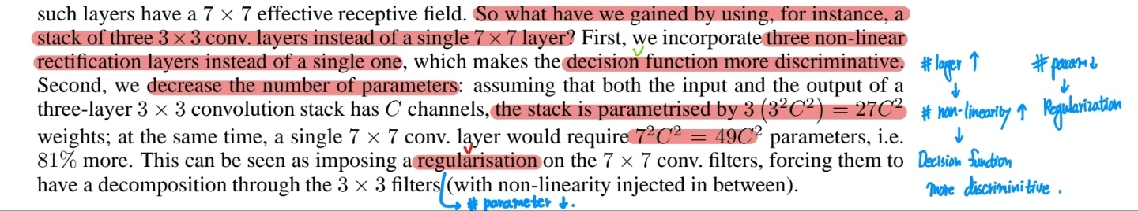
Key ideas
Why 3x3
More activations: more discriminative decision function
Decrease the number of trainable parameters: more regularization

Slide 6
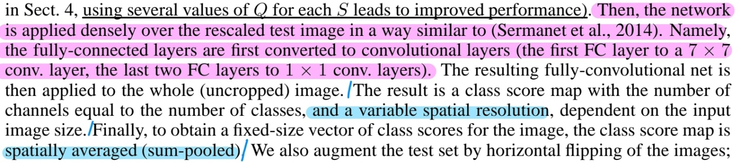
Key ideas
Testing details
Fully connected layer to fully convolutional layer: No need to sample multiple crops at test time. (spatially average class score map) ->구현X

Slide 7
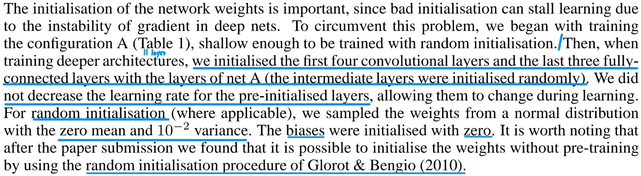
Weight initialization
Weight initialization with pre- trained net A(VGG-11). But reasonable to initialize weight with Glorot et al. 2010(Xavier initialization)
Xavier initialization doesn’t work well with ReLU activation so I applied Gaussian normal, Xavier and He initialization and compared them all.
Using batch normalization(Szegedy et al. 2015), I omitted bias term.

Slide 8
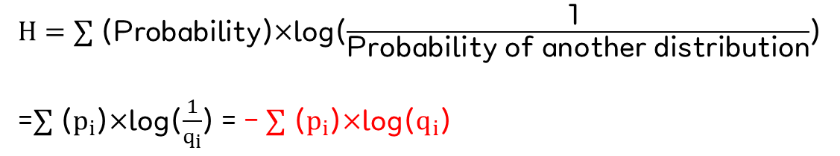
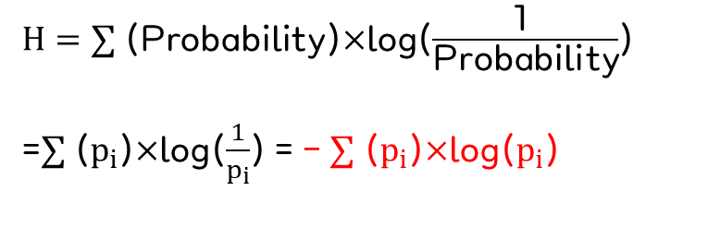
Label smoothing
Entropy
Cross-Entropy
$H=∑$ (Probability)$×$log($\frac{\text{1 }}{\text{Probability}}$)
=$∑$ ($p_{i}$)$×$log($\frac{1}{p_{i}}$) = - $∑$ ($p_{i}$)$×$log($p_{i}$)
$H=∑$ (Probability)$×$log($\frac{\text{1 }}{\text{Probability} \text{of} \text{another} \text{distribution}}$)
=$∑$ ($p_{i}$)$×$log($\frac{1}{q_{i}}$) = - $∑$ ($p_{i}$)$×$log($q_{i}$)

Slide 9
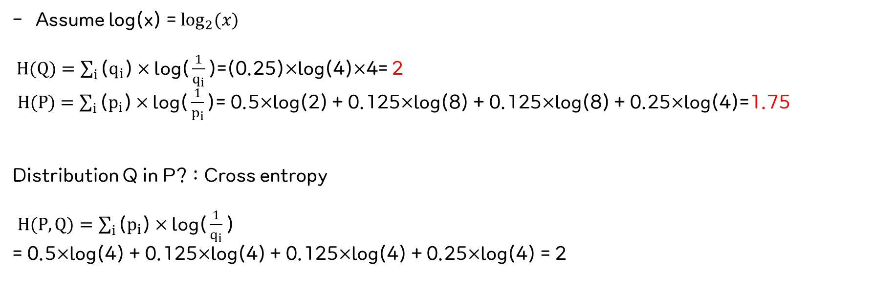
Label smoothing
Example
Probability distribution | A | B | C | D
Q | 0.25 | 0.25 | 0.25 | 0.25
P | 0.5 | 0.125 | 0.125 | 0.25
Assume log(x) = $\log_{2}{(x)}$
$H(Q)=\sum_{i}{\text{(}q_{i}\text{)}×\text{log}\text{(}\frac{1}{q_{i}}\text{)}}$=(0.25)$×$log(4)$×$4= 2
$H(P)=\sum_{i}{\text{(}p_{i}\text{)}×\text{log}\text{(}\frac{1}{p_{i}}\text{)}}$= 0.5$×$log(2) + 0.125$×$log(8) + 0.125$×$log(8) + 0.25$×$log(4)=1.75
Distribution Q in P? : Cross entropy
$H(P, Q)=\sum_{i}{\text{(}p_{i}\text{)}×\text{log}\text{(}\frac{1}{q_{i}}\text{)}}$
= 0.5$×$log(4) + 0.125$×$log(4) + 0.125$×$log(4) + 0.25$×$log(4) = 2

Slide 10
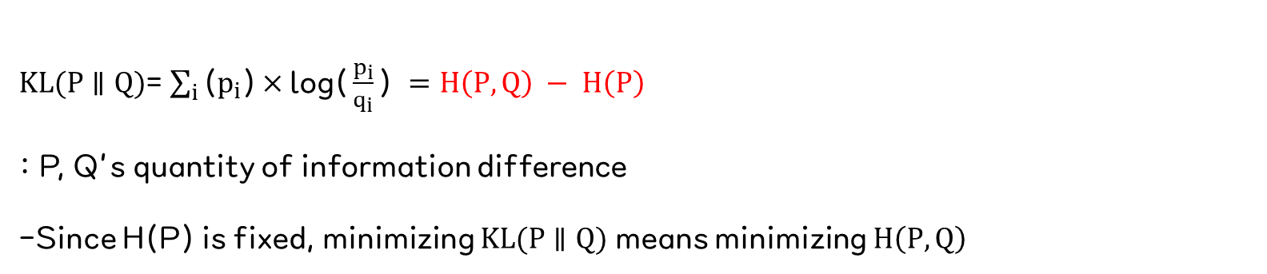
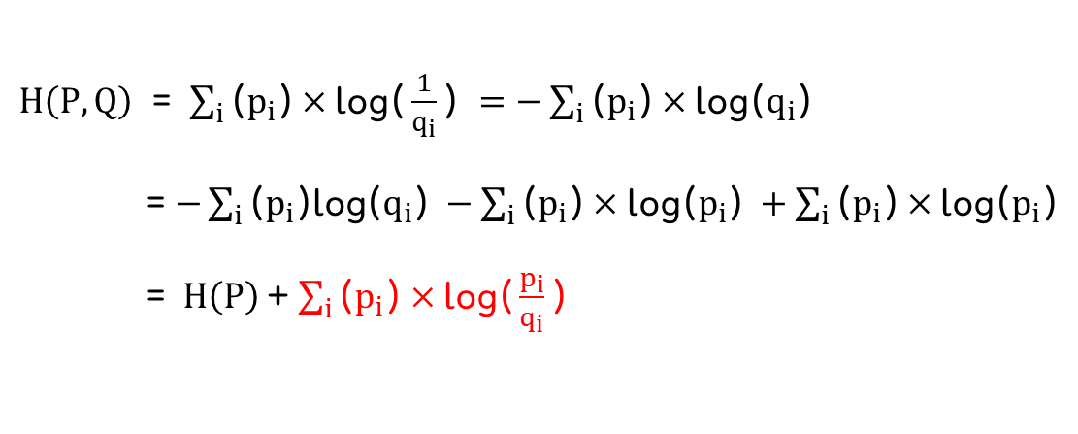
Label smoothing
Cross Entropy
$H\left(P, Q\right)$ = $\sum_{i}{\text{(}p_{i}\text{)}×\text{log}\text{(}\frac{1}{q_{i}}\text{) }=−\sum_{i}{\text{(}p_{i}\text{)}×\text{log}\text{(}q_{i}\text{)} }}$
= $−\sum_{i}{\text{(}p_{i}\text{)}\text{log}\text{(}q_{i}\text{)} }−\sum_{i}{\text{(}p_{i}\text{)}×\text{log}\text{(}p_{i}\text{)} }+\sum_{i}{\text{(}p_{i}\text{)}×\text{log}\text{(}p_{i}\text{)} }$
= $H\left(P\right)$+ $\sum_{i}{\text{(}p_{i}\text{)}×\text{log}\text{(}\frac{p_{i}}{q_{i}}\text{)} }$
K-L divergence
$KL(P∥Q)$= $\sum_{i}{\text{(}p_{i}\text{)}×\text{log}\text{(}\frac{p_{i}}{q_{i}}\text{)} =H\left(P, Q\right) − H\left(P\right)}$
: P, Q’s quantity of information difference
-Since H(P) is fixed, minimizing $KL(P∥Q)$ means minimizing $H\left(P, Q\right)$

Slide 11
Label smoothing
- Generally when computing Cross entropy P is ground-truth label(one-hot vector) and Qis probability distribution from softmax activation after several layers.
By definition of entropy, model parameters are trained for Q to be similar to P
- To prevent overconfident of model and affect of mislabeled P, and also for generalization, regularization and calibration (Guo et al. 2017) mapping P smoothly(not one-hot vector) is called label smoothing
-In this code, I compared results with setting smoothing parameter as 0, 0.15 and 0.3

Slide 12

Part 2,
Code

Slide 13
Part 2,
Code
Steps
STEP 1
STEP 2
STEP 3
STEP 4
Modify Datasets
Define model
Train, validate
Test
>>
>>
>>

Slide 14
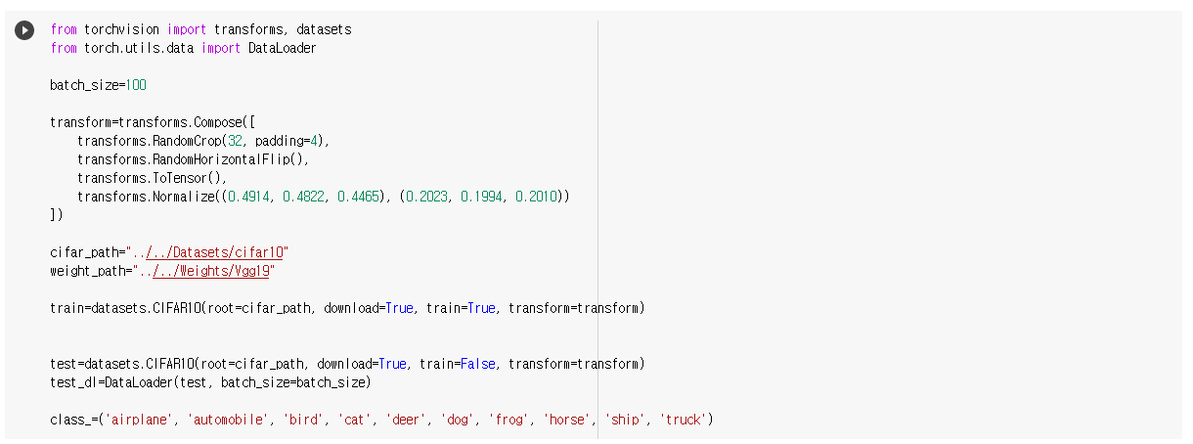
Modify datasets

Slide 15
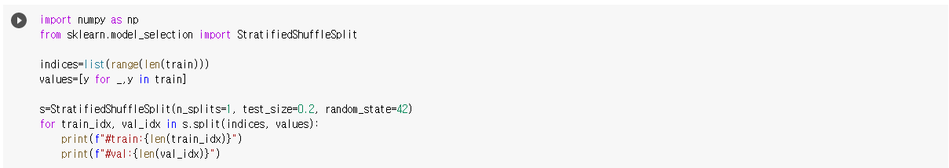
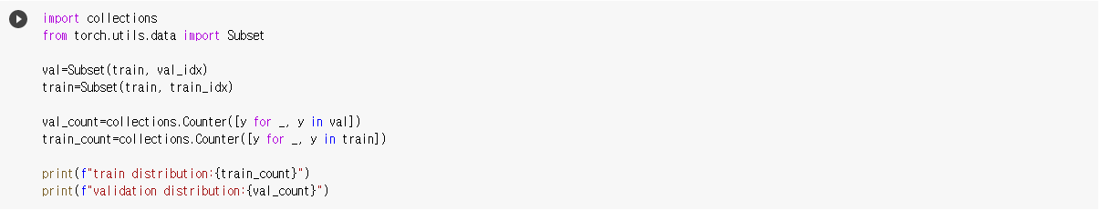
Train-validation split

Slide 16
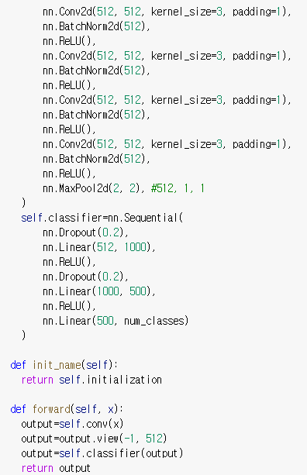
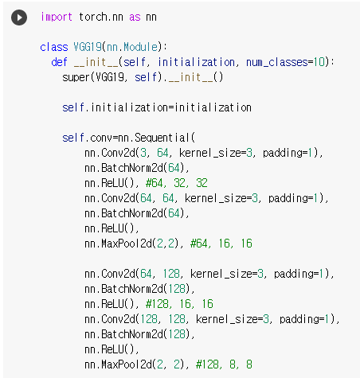
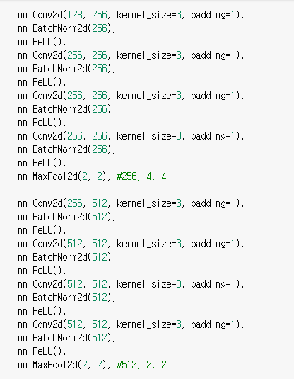
Define model
To use different initialization methods, initialize model before training.

Slide 17
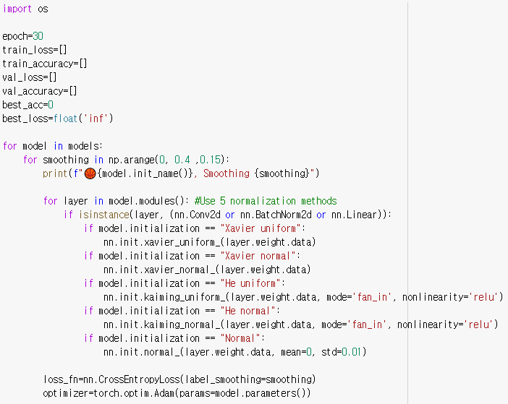
Train, validate
Initialize
1. Try 30 epoch
(10epoch로 처음에 수행 했는데, 완전히 수렴하지 않는 것
같아 epoch수를 늘려 보았습니다.)
2. Train 15 models
(5 initialization methods, 3 smoothing parameters)
3. Define loss and optimizer before train.

Slide 18
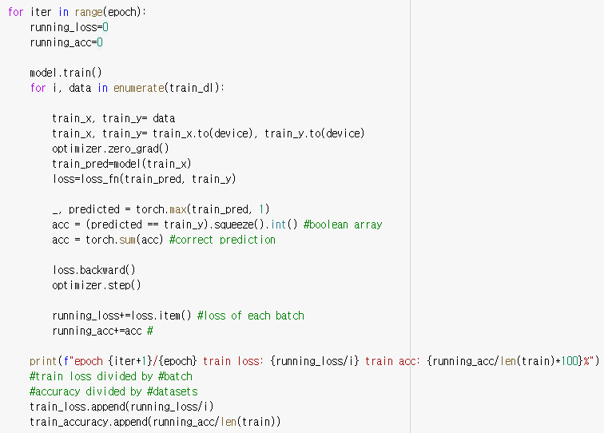
Train, validate
Train
1. Set train mode
2.Move datasets to GPU
3. Calculate loss and accuracy
(accuracy divided by #data,
Loss divided by #batch: reduction=‘mean’)
4. Append accuracy and loss to list

Slide 19
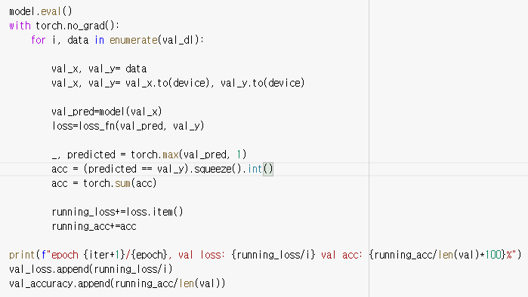
Train, validate
Validate
1. Set evaluation mode(no dropout, no batch normalization)
2. Stop calculating gradient
3. Calculate loss, accuracy and append to list

Slide 20
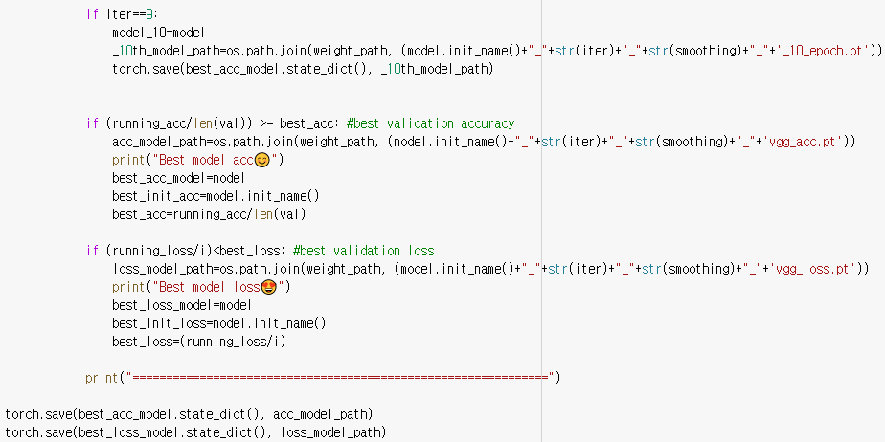
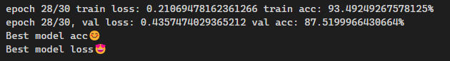
Train, validate
Save model
1. Save model after 10 epoch
2. Save model with best accuracy
3. Save model with best loss
4. Save model parameters
5. Best loss and accuracy after 28th epoch with He initialization

Slide 21
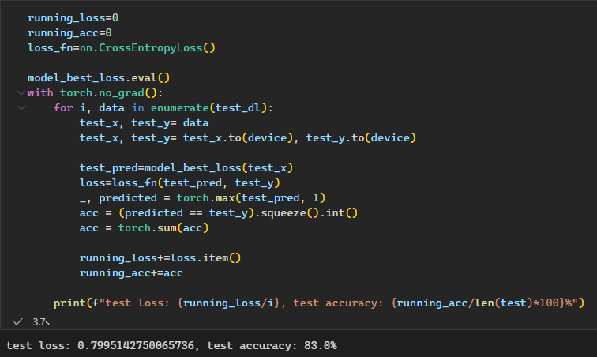
Test
Model with best accuracy

Slide 22
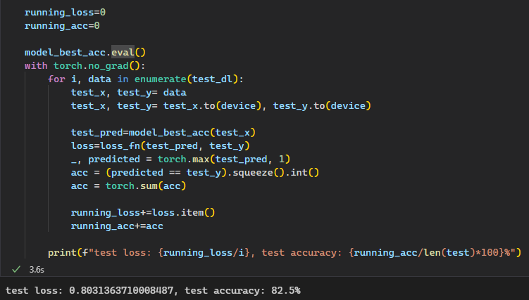
Test
Model with best loss

Slide 23

Part 3,
Result

Slide 24
Part 3,
Result
001
002
003
Test result
Initialization
Label smoothing

Slide 25
Test result
Alexnet (100epoch)
81.56%
VGG-19 (30epoch)
83%
Although #epoch decreased less than one third, test accuracy increased
New architecture with applying batch normalization and more data augmentation can be the reason

Slide 26
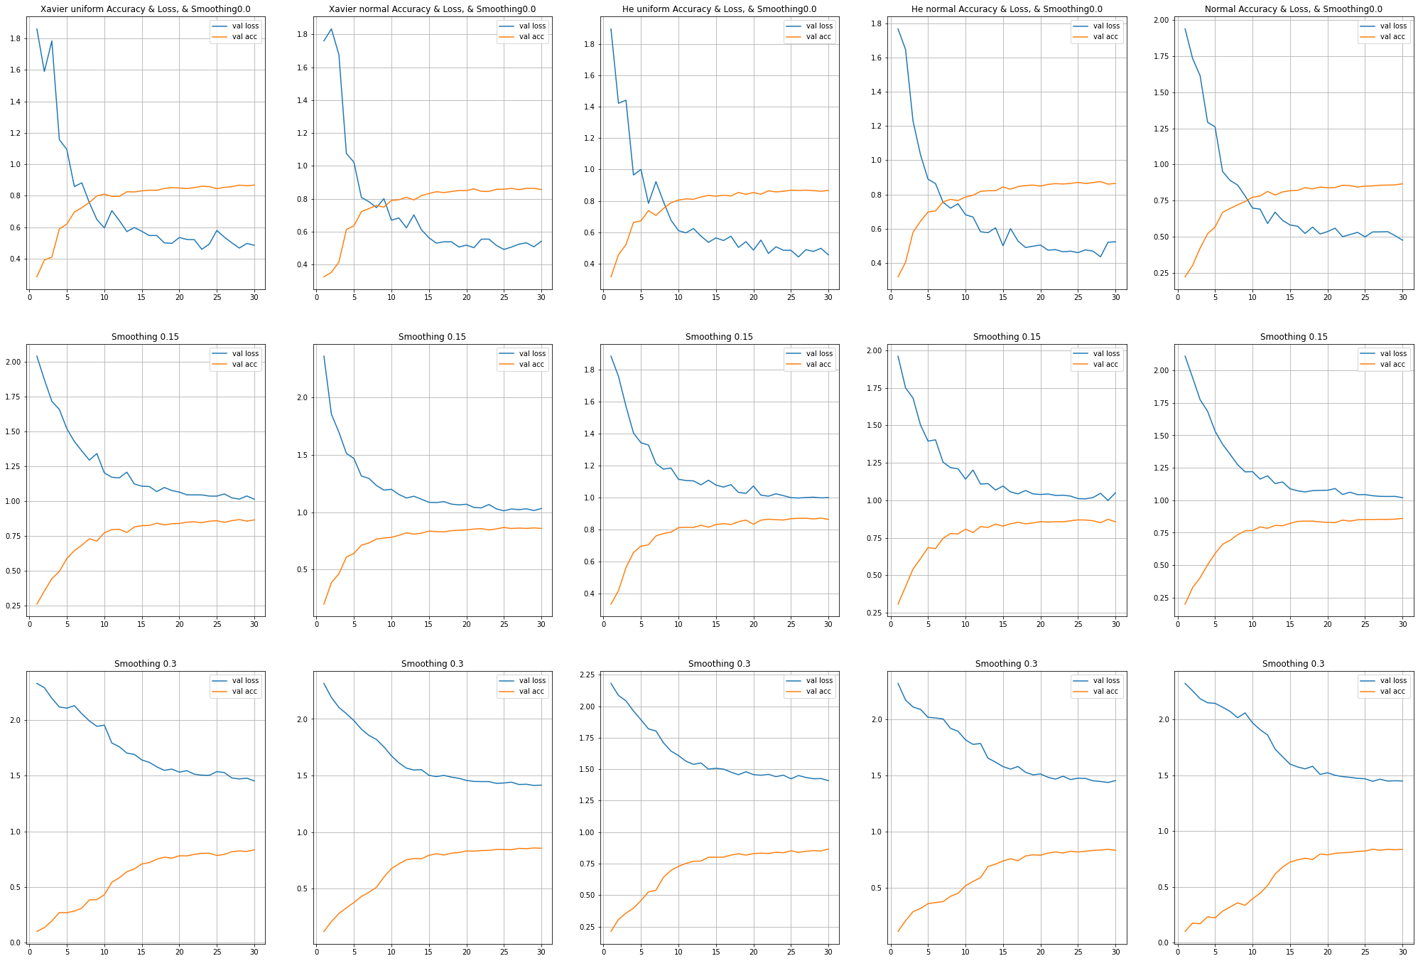
Initialization
Best validation accuracy and loss were driven after 28th epoch of model initialized by He initialization
With ReLU non-linearity, model with He initialization shows bit better performance than model with Xavier initialization
But there wasn’t dramatic difference by changing initialization method

Slide 27
Label smoothing
With more smoothing,
- Can observe regularization effect
Less prone to overshoot(less affected by batch with wrong data)
Less trained because label is ambiguous
Decreasing tendency of loss and increasing tendency of accuracy became more monotonically
: Best accuracy model will be same as best loss model! (problem of previous Alexnet)

Slide 28
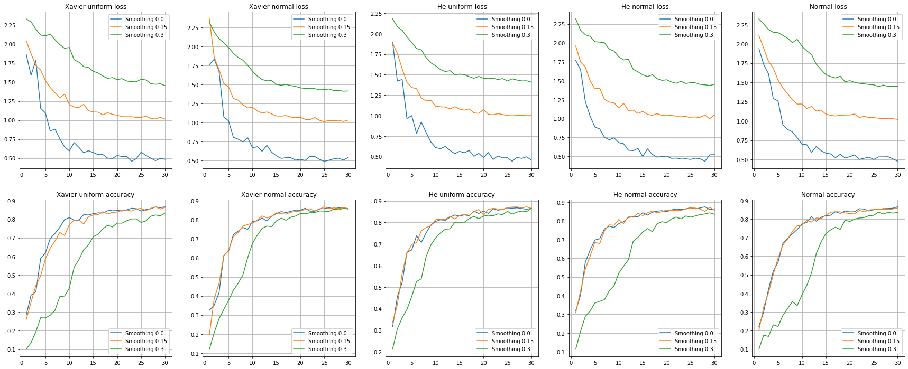
Label smoothing

Slide 29
Questions
1. Train 할 때는 마지막이 fully connected layer인데, test 할 때 fully convolutional layer로 바꾸면 train과 test의 마지막 부분에서 trainable weight들이 완전히 바뀌는게 아닌지?
그렇다면 test할 때 마지막 convolutional layer에 대한 weight 학습은 어떻게 시키는지
2. Training 과정에는 validation set과 test set 모두 관여하지 않는데, validation set에서의 결과가 더 좋은 이유가 무엇인지

